Slide 1
Informatics in NL Teachers’ professional development
Bert Zwaneveld

Slide 2
Overview
Introduction
Position of Informatics in NL; curriculum
Informatics teachers
Teaching materials and assessment
Teachers’ professional development, their views and beliefs

Slide 3
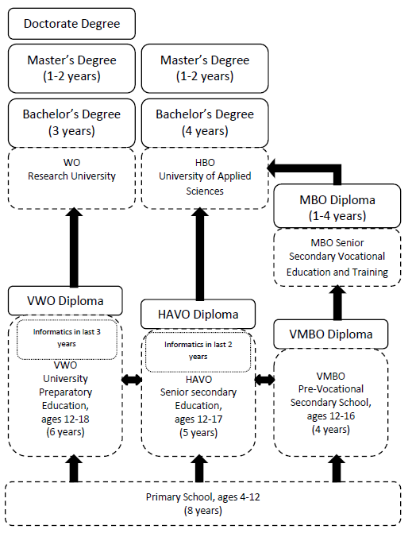
Dutch educational system

Slide 4
Position of informatics
Informatics is a selective offered by the school – but it is not a compulsory subject – in the last three year of upper VWO and last two years of upper HAVO; in 2012 55% of the schools offered informatics, 12% of the students followed it
The study load in HAVO is 320 hours, in VWO 440
Contrarily to almost all other school subjects – Dutch, English, Mathematics - Informatics is not concluded with a central examination but with only a school examination

Slide 5
Curriculum of informatics
The subject is divided in four main themes:
A Informatics in perspective: science and technology, society, education and career perspectives, and, personal resulting in a general overview; this is an integral part of other themes
B Terminology and skills: hardware, software, organization, data and information & communication.
C Systems and their structures: information issues, various types of data processing systems, and where these are normally used; it covers system theory, computer systems, real-life applications, information systems and new developments.
D Usage in a context: study of system development and project management, including social aspects; the students themselves work with Informatics and IT, in order to mix their Informatics knowledge and skills with knowledge and skills acquired in other subjects

Slide 6
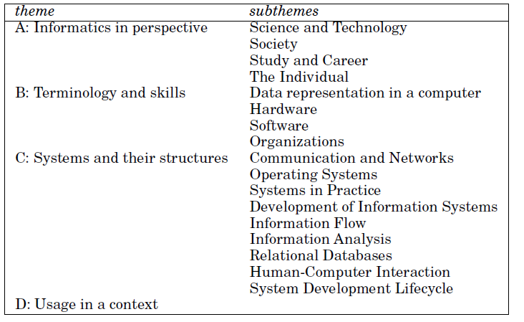
Curriculum: themes and subthemes

Slide 7
Teachers of informatics
Teachers in any upper secondary education subject should have a Masters degree in that subject and at least one year pedagogical training in that subject (first-degree certified)
But, when informatics started in 1998 in NL, there were no such teachers
So, a retraining course was organized (by a consortium of universities: CODI) for first-degree certified teachers in other subjects to bring them on a level halfway a first year of a BSc-programme in informatics (CODI-certified)

Slide 8
Results of the retraining programme and the sequel
The course – a combination of distance learning and classroom teaching – was given three times (1998 – 2006)
A course took 2 years; study load about 15-20 hours per week
About 360 teachers participated and about 330 get their certificate
Since 2006 the training of informatics teachers is done by the regular university teacher training departments
But only very few Informatics student choose for a teacher career, about 12 each year

Slide 9
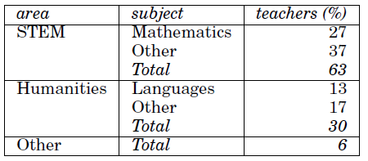
Figures about teachers (today)
50% of the informatics teachers are CODI certified
60% teach more than 6 years, 20% between 4 and 6, 10% between 1 and 3, 5% less than 1
10% is female, 90% male
17% has a MSC in Informatics
33% teach also another school subject:

Slide 10
Teaching materials; assessment
There are three Informatics textbooks
The use (in percentages, most teachers use more than one book)
Assessment (by the school) is mainly done by
Written examination
Practical assignments
(optional) a system design project

Slide 11
Teachers’ professional development (now)
They exchange information by a privately funded website
The association of Informatics teachers organizes every year a conference
Because of the background most teachers don’t qualify themselves as capable enough to assure the quality of their teaching (2007)
A PhD study showed that the PCK of programming is low to average (2012)

Slide 12
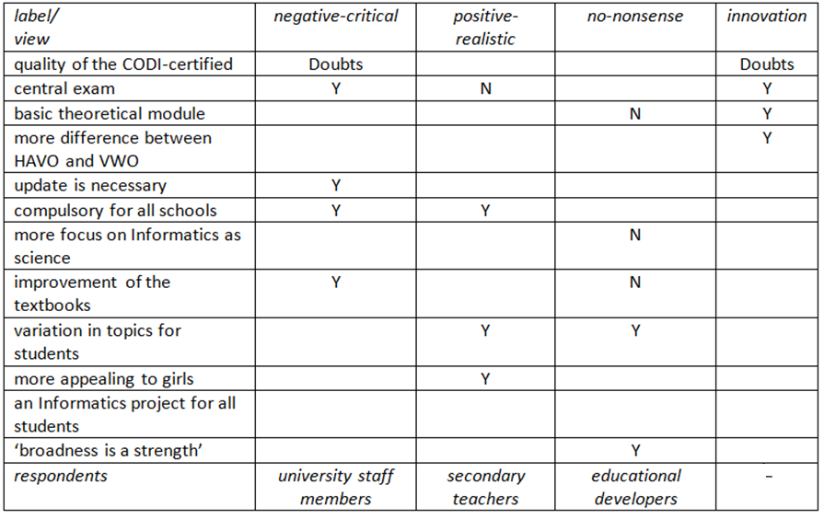
Teachers’ professional development: views and beliefs
A study to teachers’ views and beliefs among teachers and university staff members resulted in 4 ‘positions’ (2011):

Slide 13
Teachers’ professional development: context
KNAW (2012):
Less focus on computer systems, more on information and communication (I&C)
A compulsory module on I&C in lower secondary schools
Basic understanding of computers and networks (computational thinking)
Critical usage of I&C: consequences for individuals and society
Prudent behavior: norms/values, opportunities/risks, property, privacy, freedom

Slide 14
Teachers’ professional development: to be done
Even partly implementation of the KNAW recommendations makes (further) training necessary
Don’t leave this to individual schools or teachers; only a professional organization could do this, in order to (further) train the teachers with a good eye for content and quality
I plea for a new consortium: the university Informatics teacher training departments, ICT companies monitored by scientific research
I wish the vernieuwingscommissie (renovation committee?) a lot of creativity!

